Slide 1
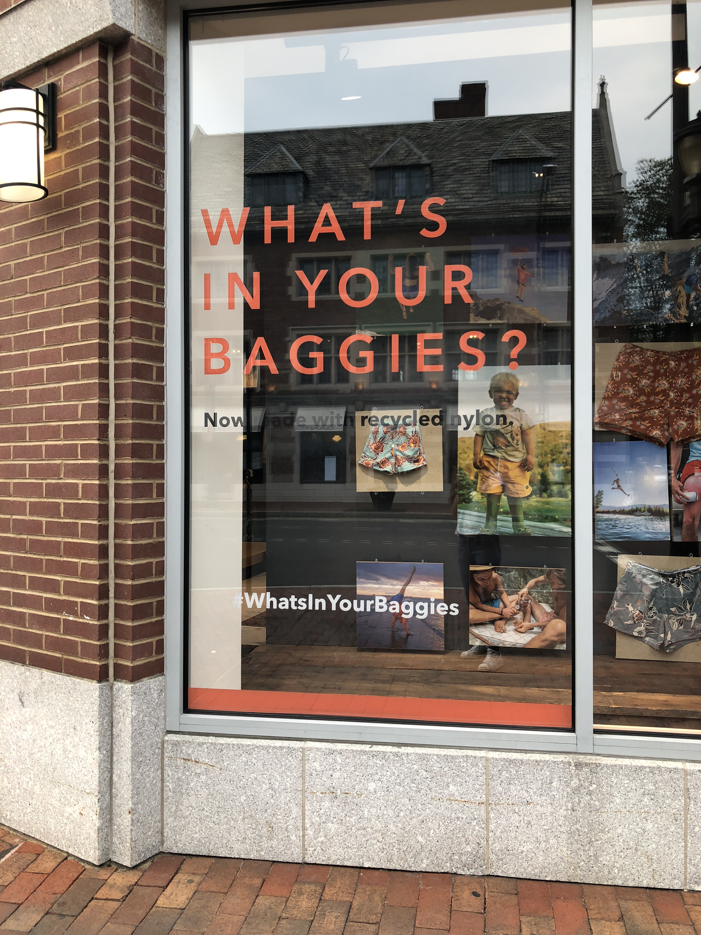
Window of the store Patagonia, on Broadway Street.
Layer 1: Wall
Layer 2: Wooden boards, clothes
Layer 3: Window with words - Adding messages
Notes:
This is an advertisement on the window of the store Patagonia, on Broadway Street. The bottom layer is a wall in the store, acting as a canvas. On top of it, there are pictures printed on wooden boards. Particularly, there are also pieces of clothe fixed on the wooden boards, as the display for the physical products. The window as the upper most layer is adding messages, which are also caption for tthe overall image formed.
Window, lighting differences
Screenshots of ur desktop-self generated data
staging

Slide 2
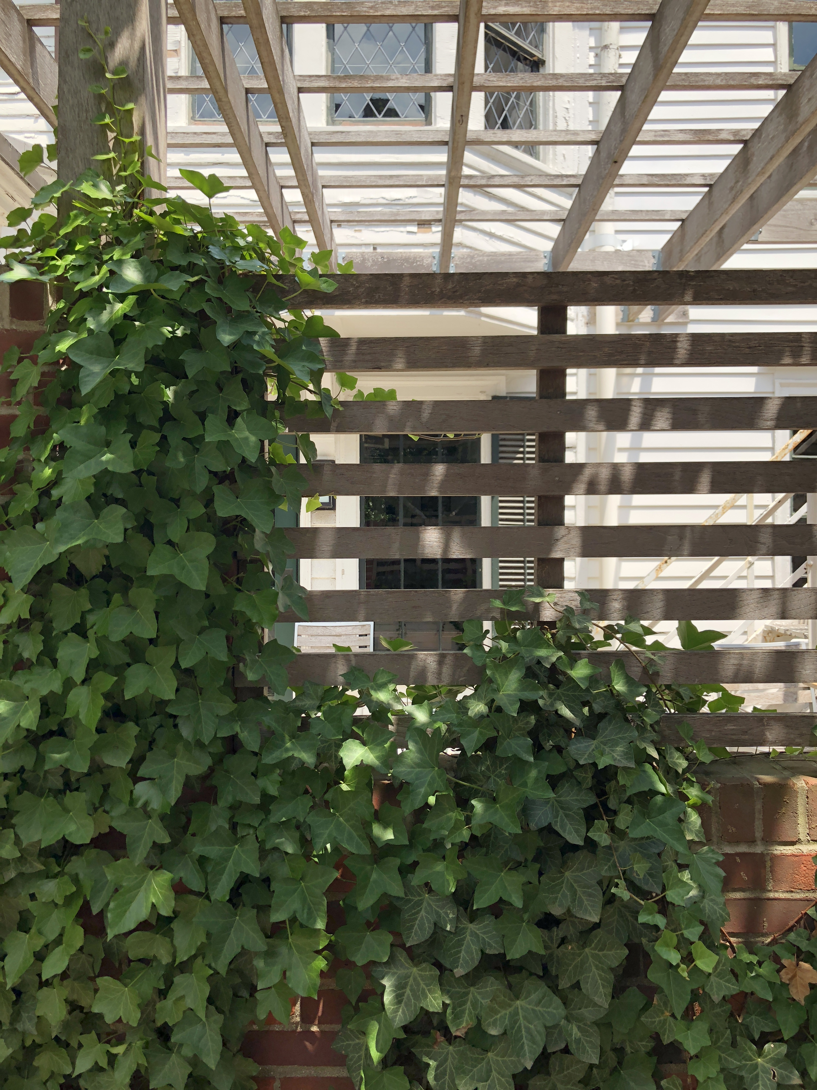
Window of the store Patagonia, on Broadway Street.
Layer 1: Interior of the house
Layer 2: Window
Layer 3: Fence Hiding the view inside, creating distance
Notes:
This is the view on Broadway Street, with at least 3 layers. At the first layer, counting from the bottom, there is a there is a fence with vine growing on it. It separated the house with the street. The second layer is the window of the building.

Slide 3
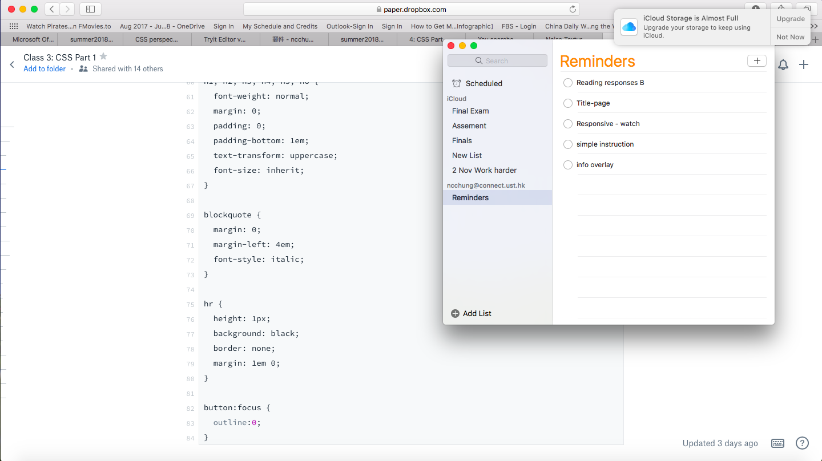
Screenshot from my computer Layer 1: Desktop Layer 2: Window of Safari Layer 3: Window of Reminder Layer 4: Reminder message from iCloud Each layer provides different information
Notes:
This is the screenshot of my computer. T

